Slide 1

OELP (ID 2802) Project Title: Personalized Chatbot Development for Aphasia Patients
Name: Parvat
Roll no: 122201043
Faculty mentor: Abdul Rasheed P

Slide 2
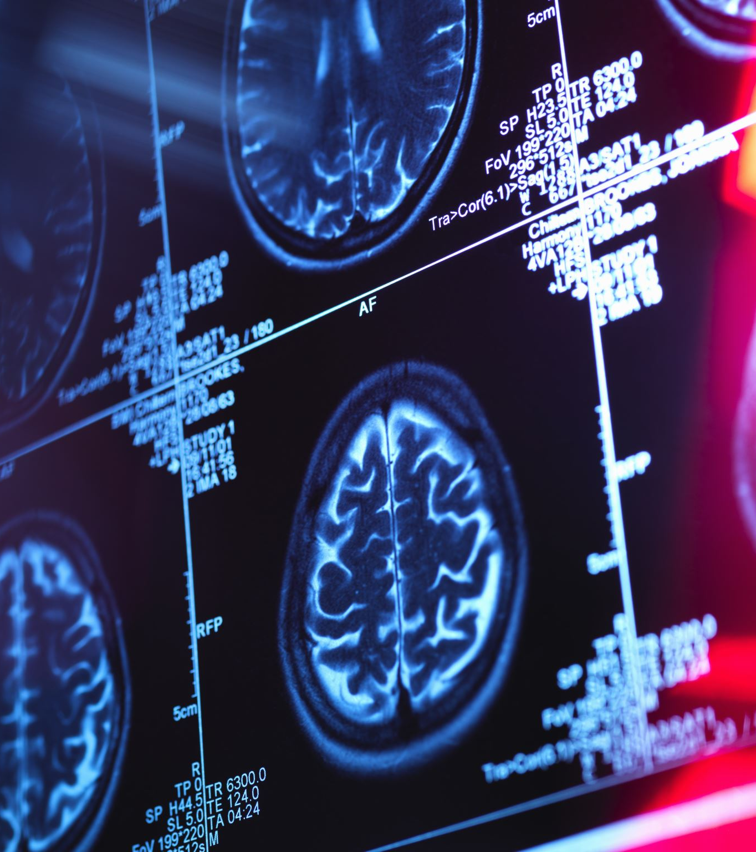
Background
Aphasia, a communication disorder often resulting from brain damage, hampers language comprehension and speech formation, impacting daily interactions and quality of life. Traditional therapy methods may not always suffice due to various constraints. Technology has shown promise in aiding communication for aphasia patients, but current solutions lack personalization and adaptability.

Slide 3

Challenge Statement
Developing a personalized chatbot presents a crucial challenge in addressing the unique needs and progress of individuals with aphasia. This involves integrating advanced speech recognition technology, designing a user-friendly interface, and implementing dynamic algorithms to tailor communication styles. Collaboration across disciplines and rigorous user testing are essential for success.

Slide 4

Solution Aim
This project aims to create a personalized chatbot to assist aphasia patients in overcoming communication barriers. The objectives include designing an adaptable interface, integrating speech recognition, and incorporating dynamic feedback mechanisms. Through this innovative approach, we seek to enhance the lives of individuals with aphasia, improving their communication abilities and overall wellbeing.

Slide 5
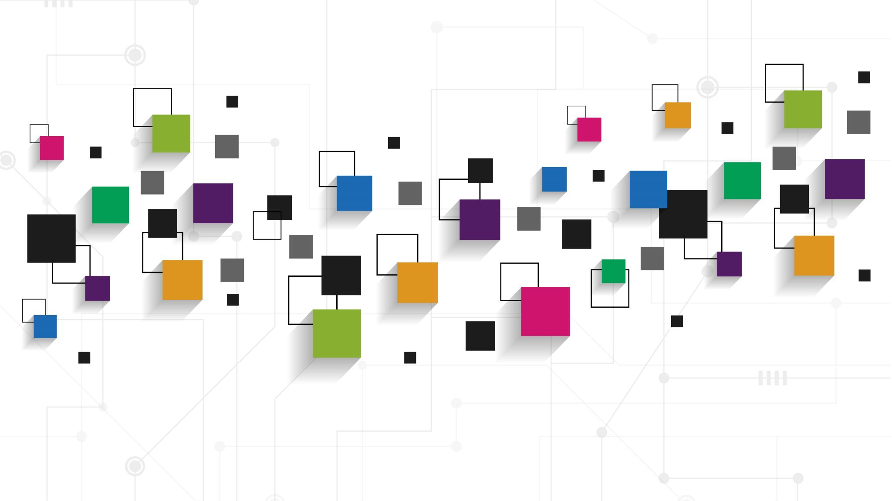
OBJECTIVES
Chatbot Design: Develop a user-friendly and personalized chatbot interface tailored to the unique requirements and preferences of aphasia patients.
Adaptability: Create a dynamic chatbot that can adapt its communication style and pace based on individual patient progress and preferences.
Speech Recognition Integration: Implement advanced speech recognition technology to enhance the chatbot's ability to understand and respond to varying speech patterns associated with aphasia.
User-Friendly Interface: Design an intuitive and easy-to-navigate interface specifically tailored to the needs of aphasia patients. Consider factors such as clear and readable fonts, intuitive navigation options, and minimal distractions to ensure a positive user experience.
User Testing and Feedback: Conduct rigorous user testing with aphasia patients to gather valuable feedback for continuous improvement and refinement of the chatbot

Slide 6
Methodology
Importing necessary libraries and modules
Designing the chatbot
Implementing the adaptability
Integrating the speech recognition system
Designing the interface
User testing and feedback

Slide 7
Important libraries used
json: Used for working with JSON files.
difflib: Utilized for finding close matches of strings.
numpy: Employed for numerical operations.
nltk: Utilized for natural language processing tasks such as tokenization and lemmatization.
string: Used for string manipulation operations.
random: Employed for generating random numbers and choices.
sklearn: Used for TF-IDF vectorization and cosine similarity calculations.
warnings: Utilized for handling warnings.
os: Employed for interacting with the operating system.
tkinter: Utilized for creating GUI applications.
streamlit: Used for creating web-based interactive applications.
pyttsx3: Employed for text-to-speech conversion.
speech_recognition: Utilized for speech recognition functionality.
pyaudio: Employed for audio input/output operations.

Slide 8

Design and Adaptability
For the the first two goals mentioned in the presentation. We've created a chatbot that can work in two different ways: chat mode and translate mode. You can switch between these modes anytime by typing "switch“. The modes are explained in the upcoming slides.

Slide 9
TRANSLATE MODE(OBJECTIVE I)
In this mode, the chatbot helps understand what patients are saying. It's like a translator, making it easier to communicate, especially as patients speak slightly different language. It is based on AI concepts like lemmatization, tokenization and vectorization

Slide 10

TRANSLATE MODE(OBJECTIVE I)
1.Tokenization:
Tokenization is the process of breaking down a text or document into smaller units, called tokens. These tokens can be words, phrases, or even individual characters, depending on the level of granularity needed. Tokenization helps in preparing text data for further analysis or processing. For example, in a sentence like "The quick brown fox jumps over the lazy dog," tokenization would break it down into individual words: ["The", "quick", "brown", "fox", "jumps", "over", "the", "lazy", "dog"].

Slide 11

TRANSLATE MODE MODE(OBJECTIVE I)
2.Lemmatization:
Lemmatization is the process of reducing words to their base or root form, called a lemma. It involves removing inflections and variations to bring words to their dictionary form. For example, the lemma of the words "running," "ran," and "runs" is "run." Lemmatization helps in normalizing text data, reducing different forms of words to a common base form. This is particularly useful in tasks like text analysis, where we want to treat different forms of the same word as equivalent.

Slide 12

TRANSLATE MODE(OBJECTIVE I)
3.Vectorization:
Vectorization is the process of converting text data into numerical vectors, which can be understood and processed by machine learning algorithms. In natural language processing (NLP), text data needs to be converted into numerical form for tasks like classification, clustering, or regression. Vectorization methods include techniques like Bag-of-Words (BoW), Term Frequency-Inverse Document Frequency (TF-IDF), and word embeddings (e.g., Word2Vec, GloVe). These methods represent text data as vectors in high-dimensional spaces, where each dimension corresponds to a unique term or word in the vocabulary. Vectorization allows algorithms to perform mathematical operations on text data, enabling tasks like similarity measurement, classification, and clustering.

Slide 13
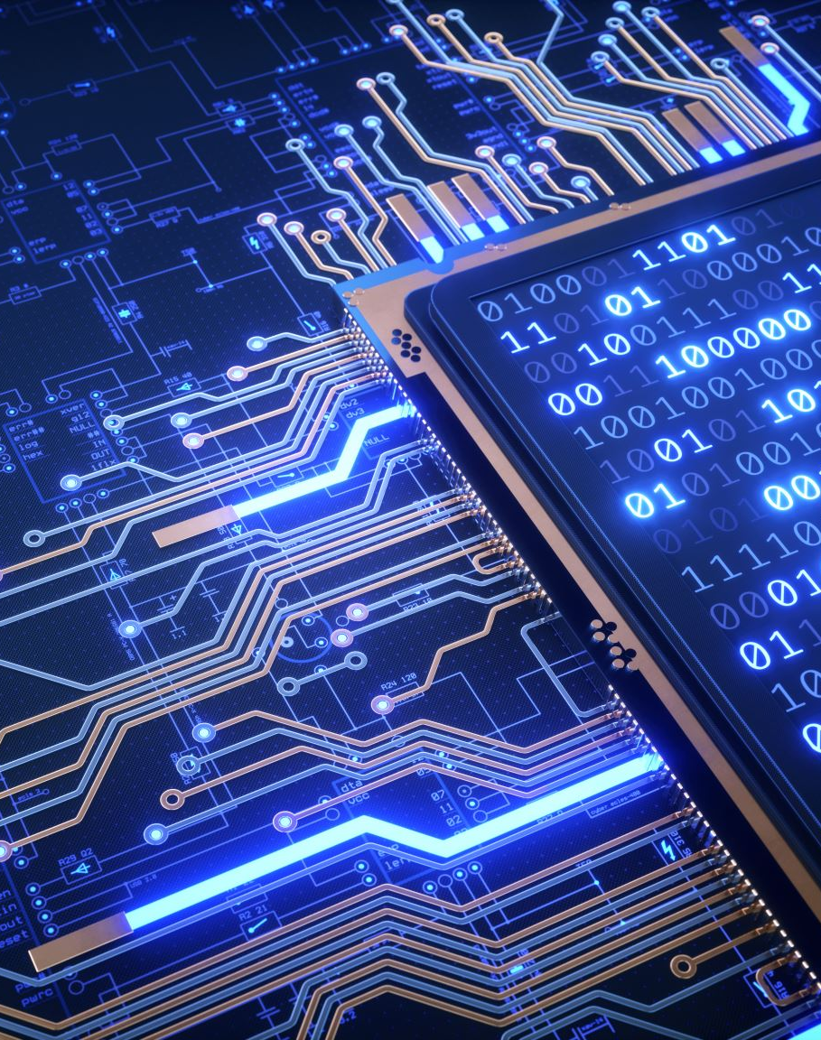
TRANSLATE MODE(OBJECTIVE I)
In summary, tokenization breaks down text into smaller units (tokens), lemmatization reduces words to their base forms, and vectorization converts text data into numerical vectors for machine learning algorithms to process. These concepts are fundamental in natural language processing and are essential for building AI systems that understand and process text data effectively.

Slide 14

CHAT MODE(OBJECTIVE II)
In chat mode, the chatbot learns from talking to people. It gets better at chatting over time because it learns from the conversations it has. This helps it understand and respond better to what people say.

Slide 15

CHAT MODE(OBJECTIVE II)
In chat mode, the chatbot behaves like a self-learning student, responding to user queries based on its knowledge database. If the chatbot encounters a question it doesn't know the answer to, it politely asks the user to teach it. The user can either provide an answer or choose to skip the question. If the user teaches the chatbot, it learns and remembers the response for future interactions, gradually improving its knowledge base over time. This interactive learning process helps the chatbot become more helpful and accurate in its responses as it gains experience from user interactions.

Slide 16
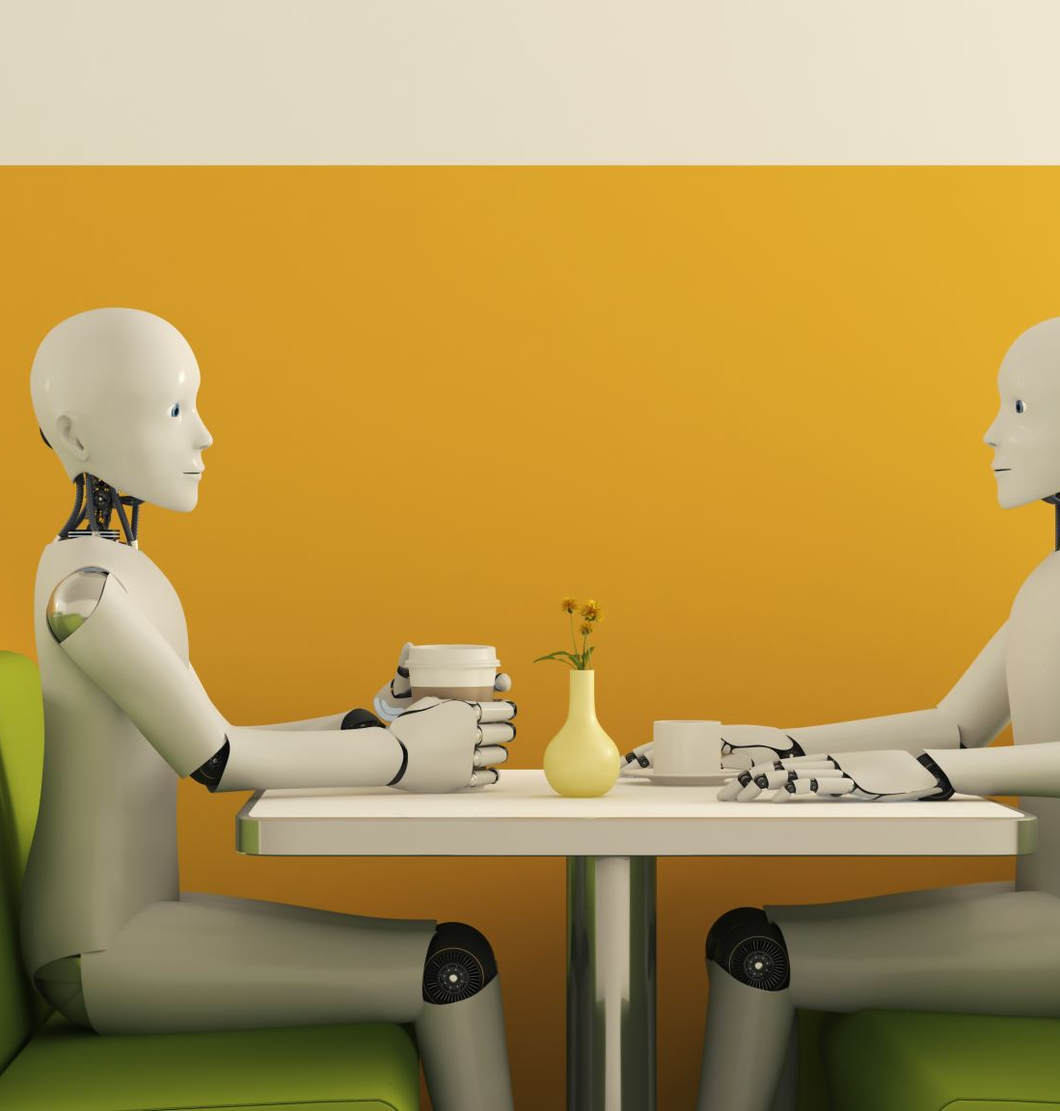
Speech Recognition Integration: Enhancing Interaction with Voice
Our chatbot also has features speech recognition technology, allowing users to interact with it using their voice. Simply speak to provide input to the bot, and it will understand your words and respond accordingly. Additionally, the bot can deliver its responses in audio format, enabling a seamless and natural conversation experience for users.

Slide 17

User friendly interface
The chatbot has two ways to talk to it: one online and one offline. If you have internet, you can use the online way through Streamlit. But if you don't have internet, no worries! You can still chat with the chatbot using the offline way through Tkinter. It's all about giving you options that work for you!

Slide 18
Working of Chatbot
Input
Chat mode
Translate mode
Preprocessing data
Preprocessing data
Normalization
Lemmatization, tokenization and vectorization
Selecting best match from Json file or asking user to teach manually
Selecting best match from txt file
Output
Output

Slide 19
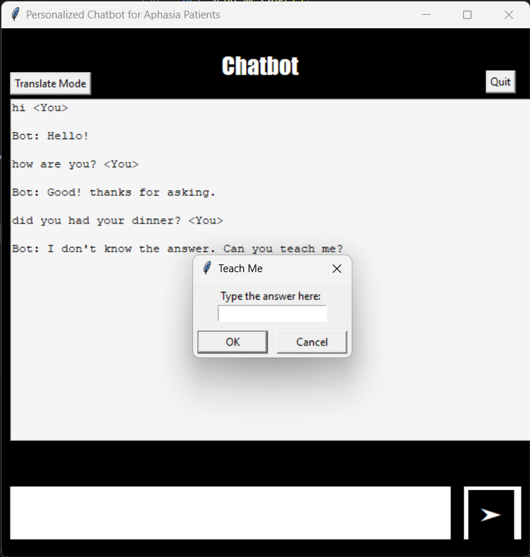
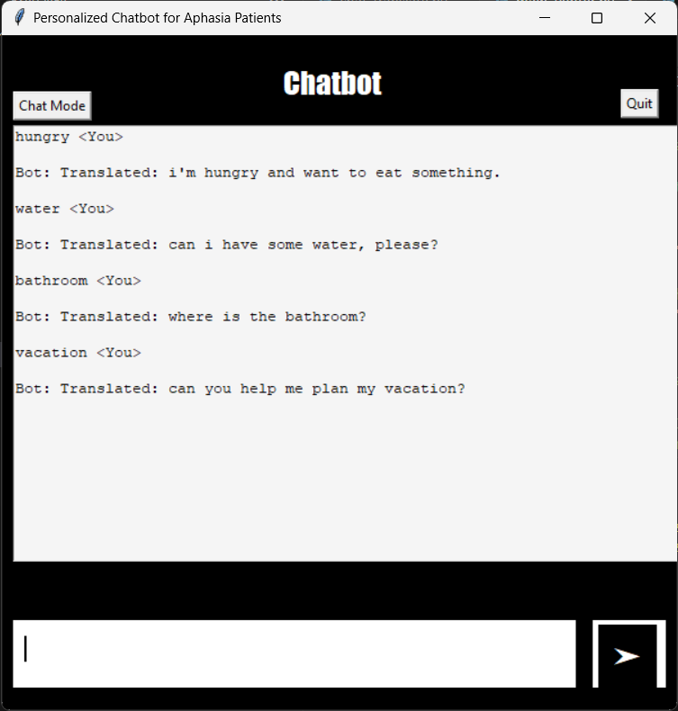
Result: Interface for offline mode
Chat mode
Translate mode

Slide 20
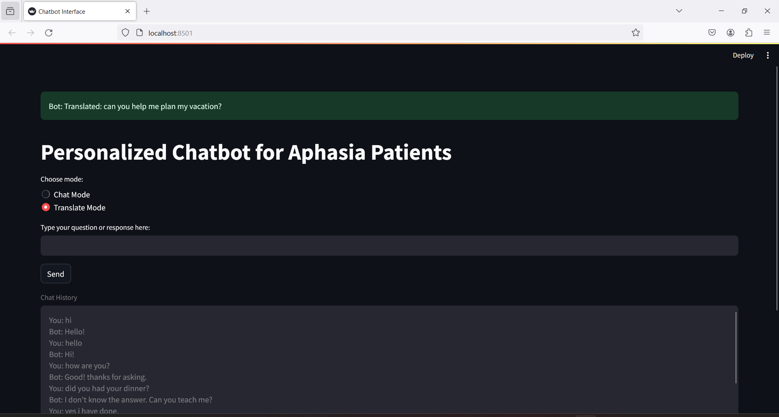
Result: Interface for online mode

Slide 21

Github repository
Link: https://github.com/parvatkhattak/Docbot-for-Aphasia-Patients

Slide 22

THANK YOU

